Slide 1

DZZAH Gym Managment

Slide 2

TEAM MEMBER
01
Marwan El Desouki
02
Zeiad Ahmed
03
Habiba Amr

Slide 3
No Pain No Java

Slide 4
Introduction :
Gym management system, if we take the current system and compare with the proposed it is far behind. Every work in the existing is manual and done on the paper. Login form will appear to user (Admin , Coach & Member Dashboards)

Slide 5
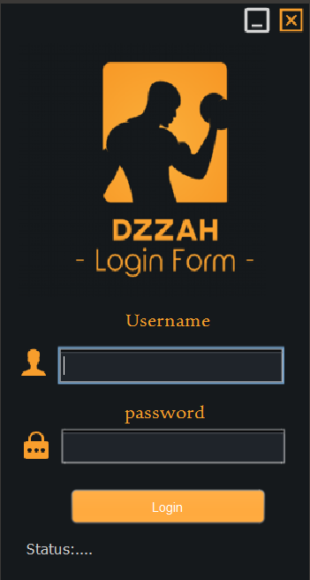
Login Form

Slide 6



Dashboard Forms
Admin
Coach
Member

Slide 7
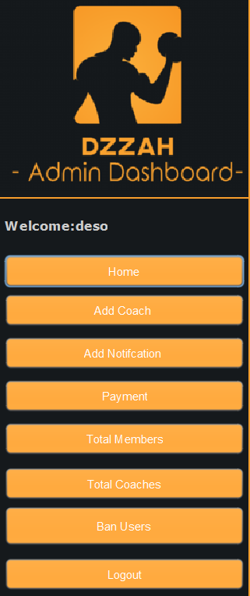
Admin Dashboard
Home
Payment
Add Coach
Total Member
Text Here
Get a modern PowerPoint Presentation that is beautifully designed.
02
Add Notification
Total Coaches
01
Ban Form
Logout

Slide 8
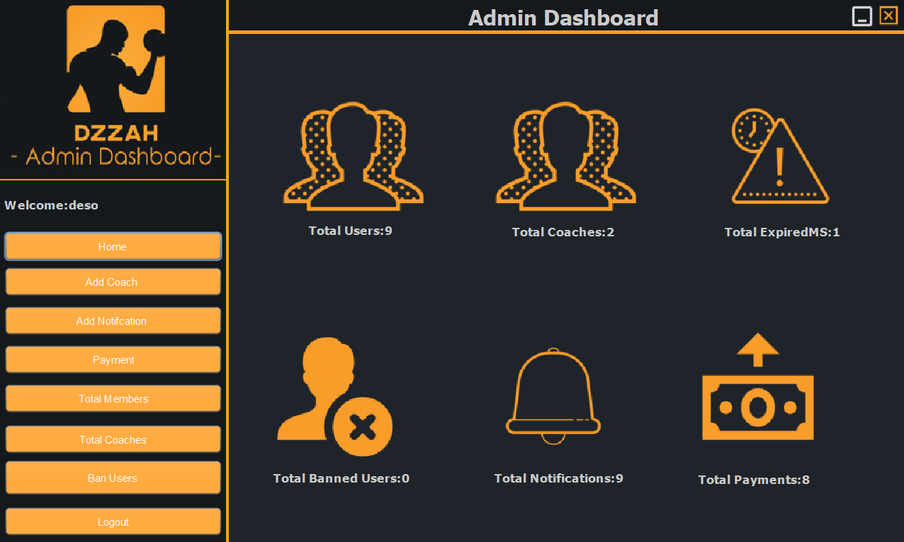
Home Form

Slide 9
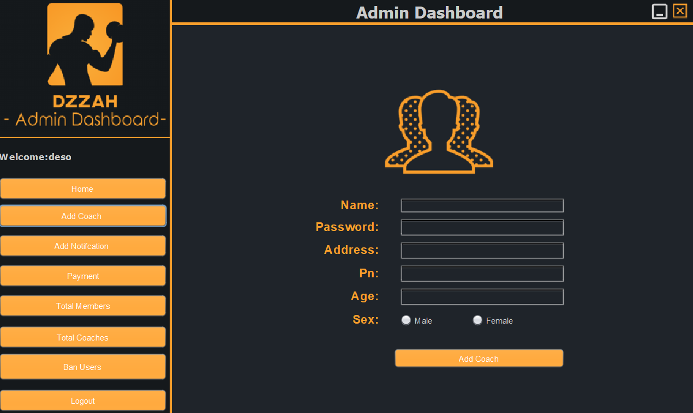
Add Coach Form

Slide 10
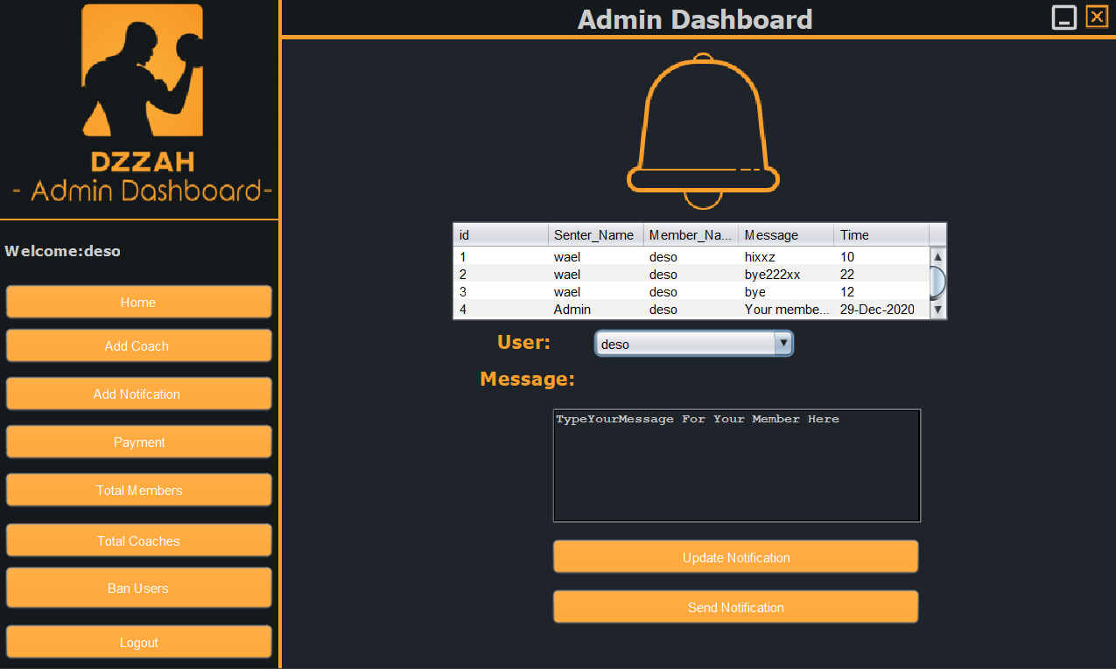
Add Notification Form

Slide 11
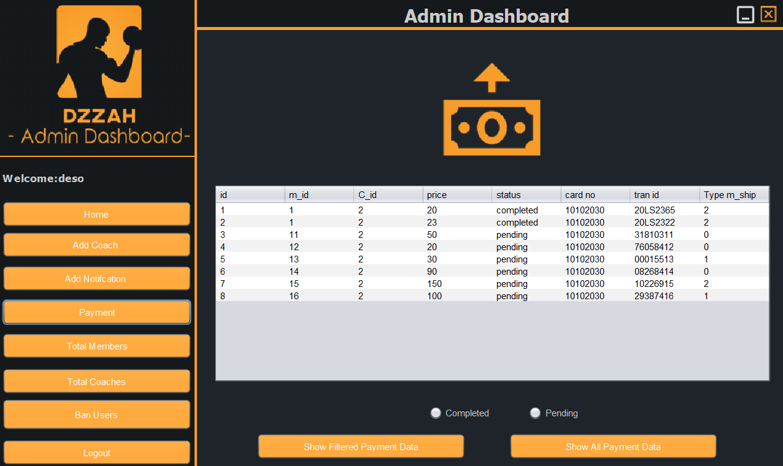
Payment Form

Slide 12
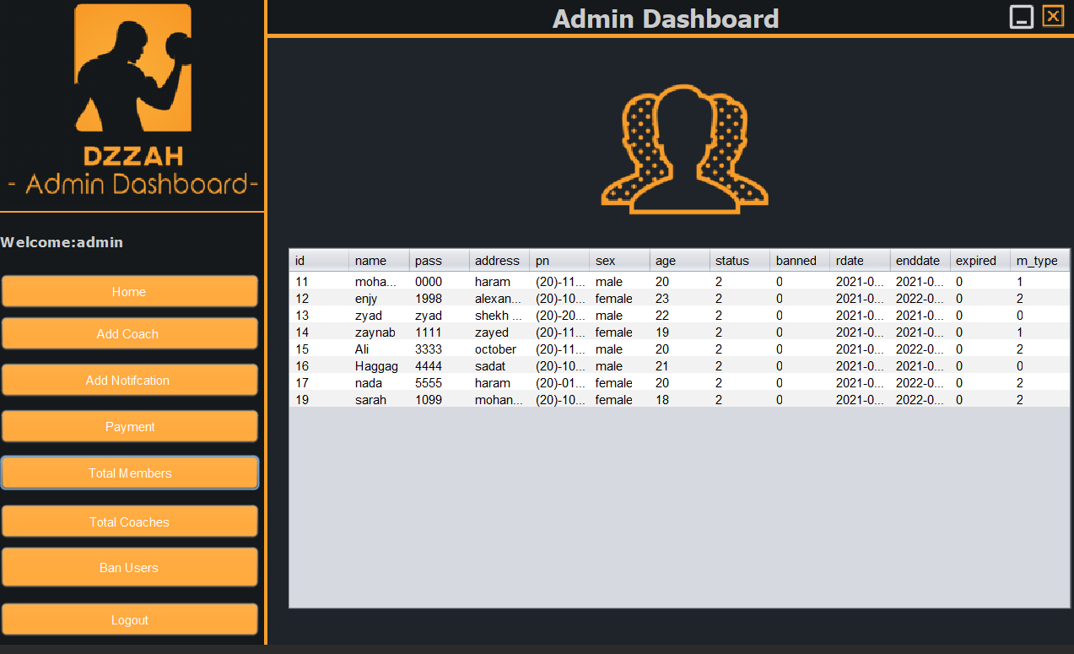
Total Members Form

Slide 13
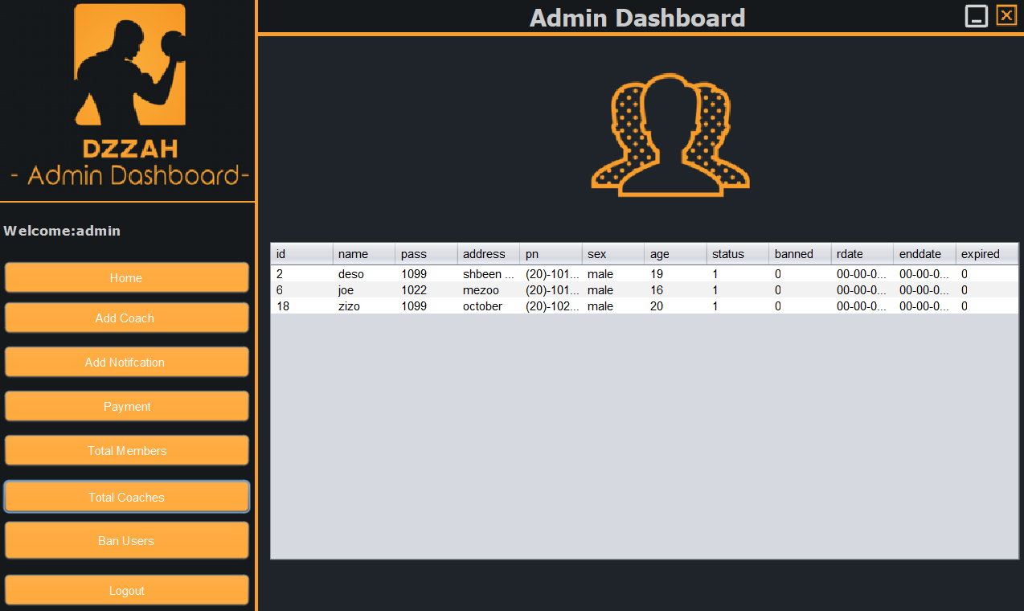
Total Coaches Form

Slide 14
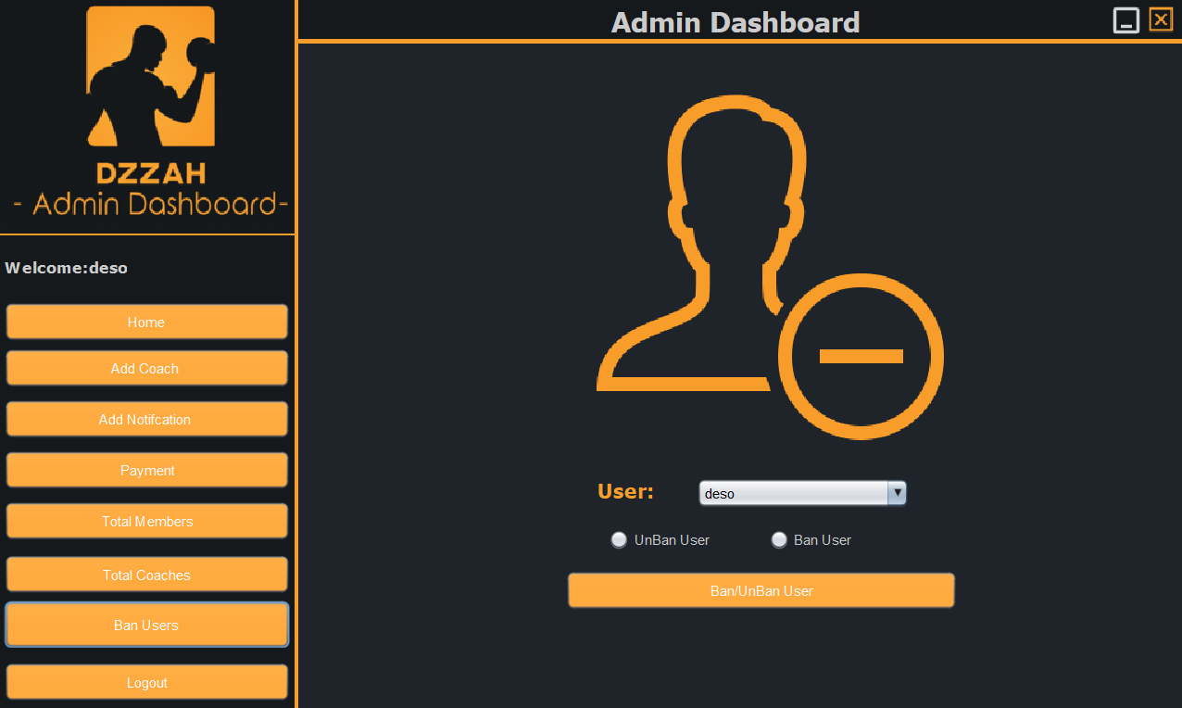
Ban Users Form

Slide 15
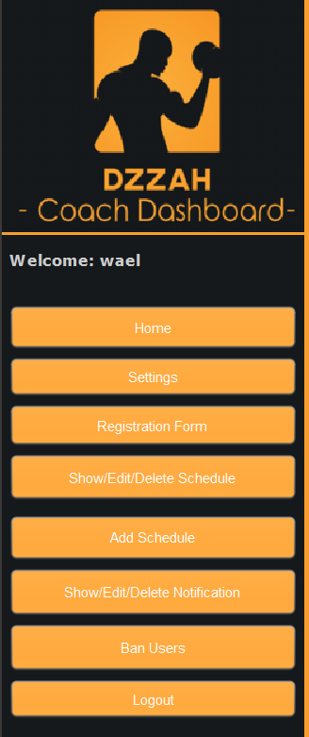
Coach Dashboard
Home
Show Schedule
Settings
Add Schedule
Registration form
Show Notification
Ban form
Logout

Slide 16
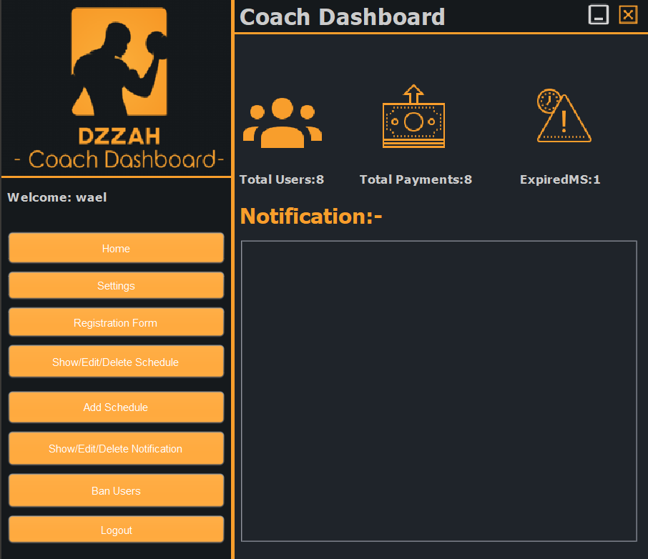
Home Form

Slide 17
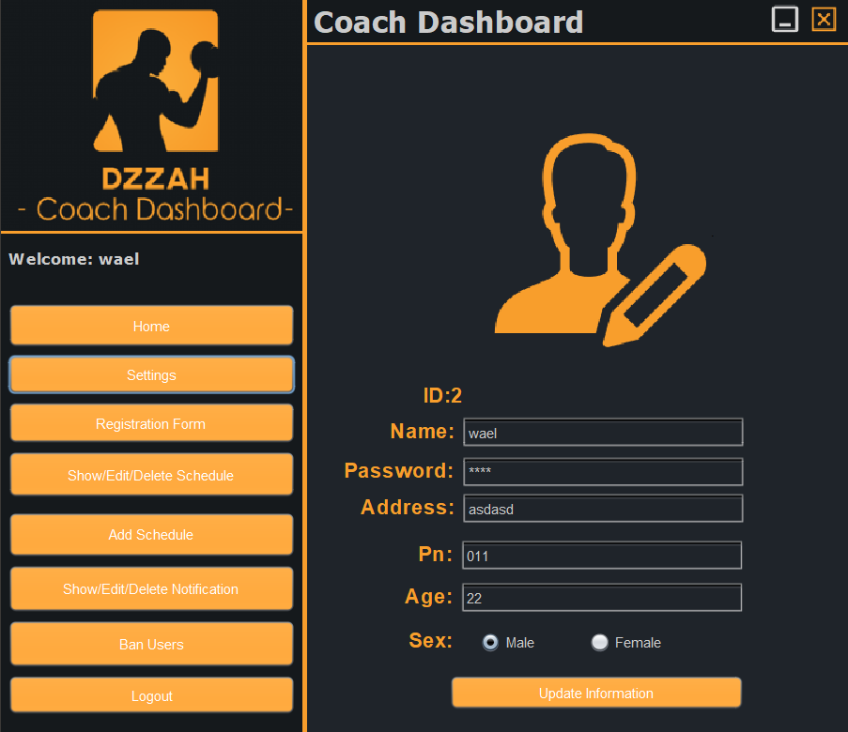
Settings Form

Slide 18
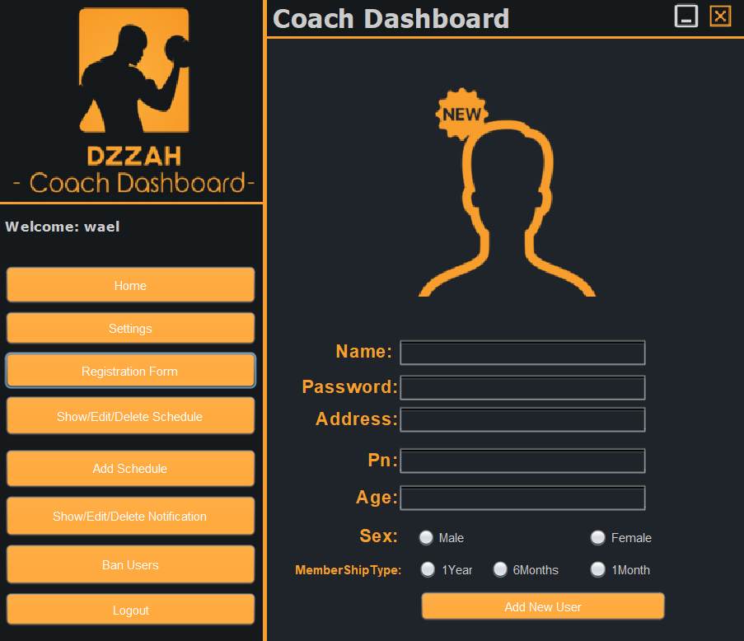
Registiration Form

Slide 19
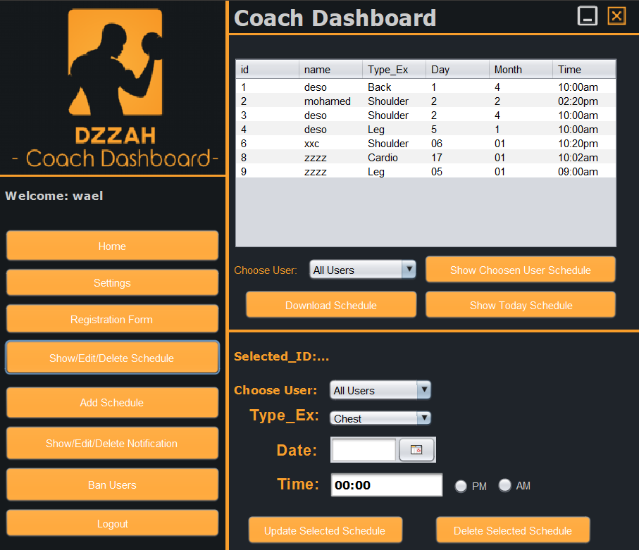
Show/Edit/Delete Schedule Form

Slide 20
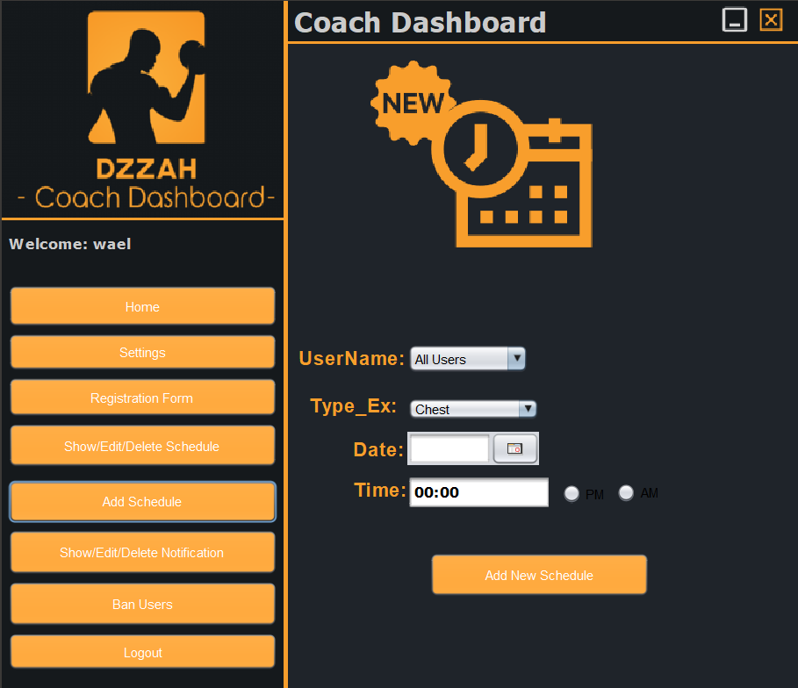
Add Schedule Form

Slide 21
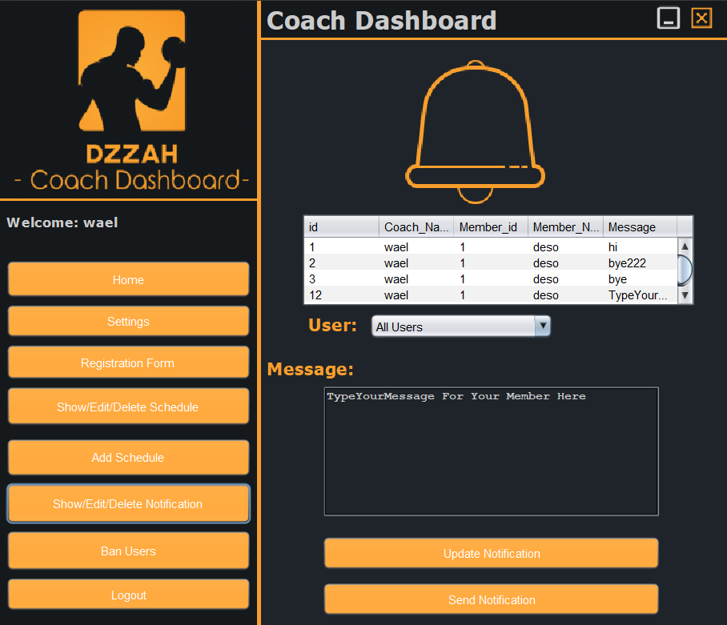
Show/Edit/Delete Notifications Form

Slide 22
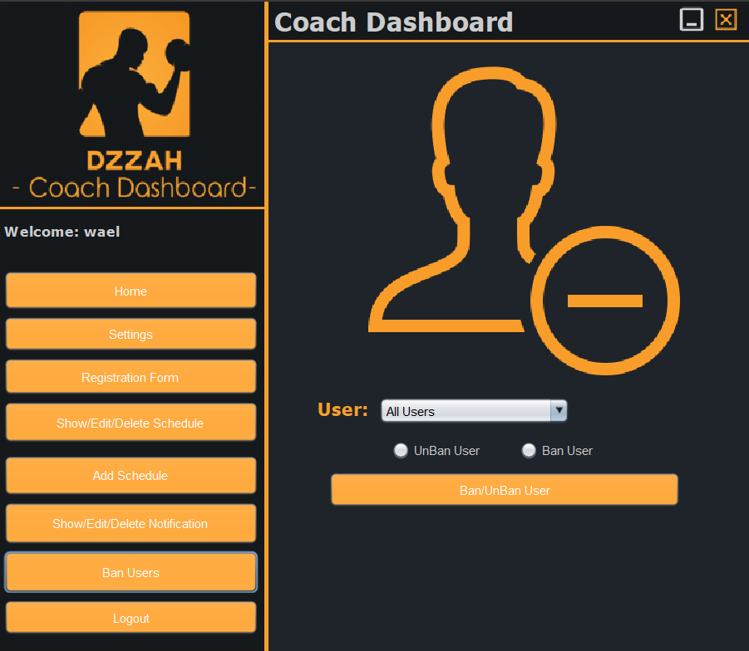
Ban Users Form

Slide 23
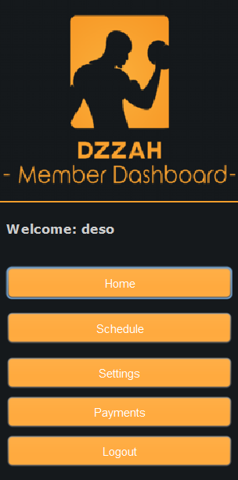
Member Dashboard
Home
Settings
Schedule
Payments
Logout

Slide 24
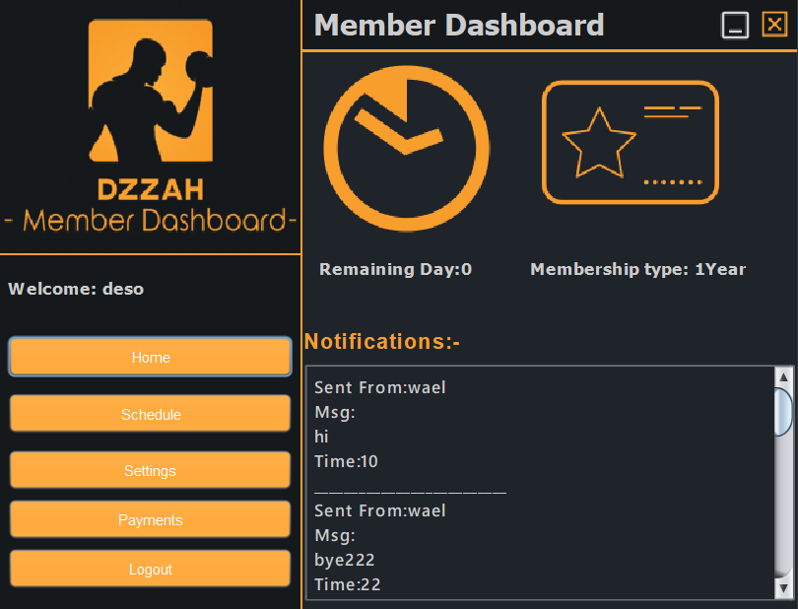
Home Form

Slide 25
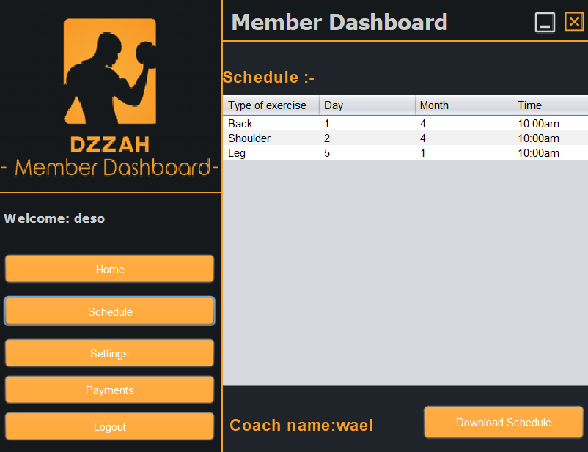
Schedule Form

Slide 26
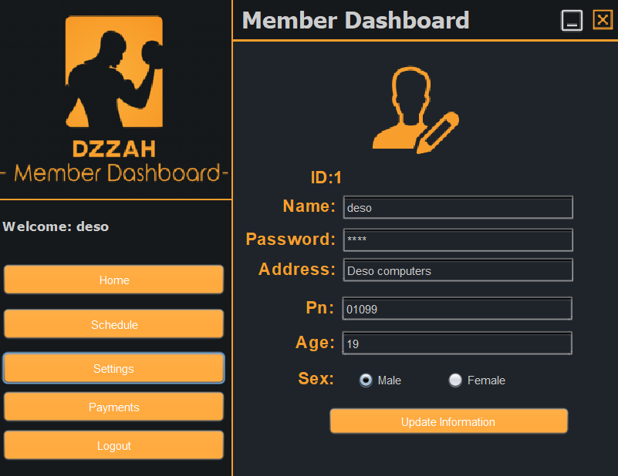
Settings Form

Slide 27
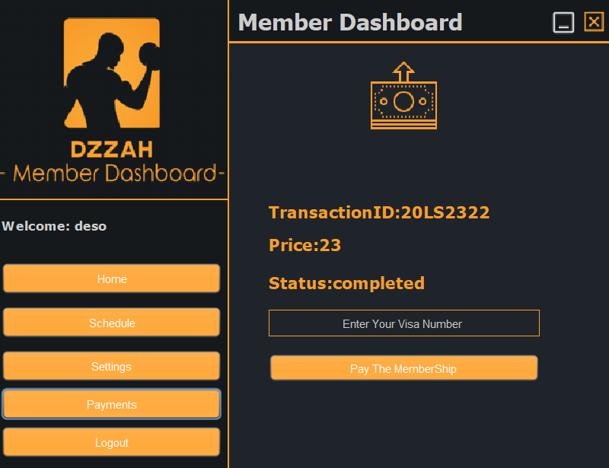
Payments Form

Slide 28
Thank you

